Slide 1

STAT 642 Data Mining 2023
Final project Kaggle competition
Group Members :
Mohil Jain
Taha Talwala
Vedant Chhibber

Slide 2
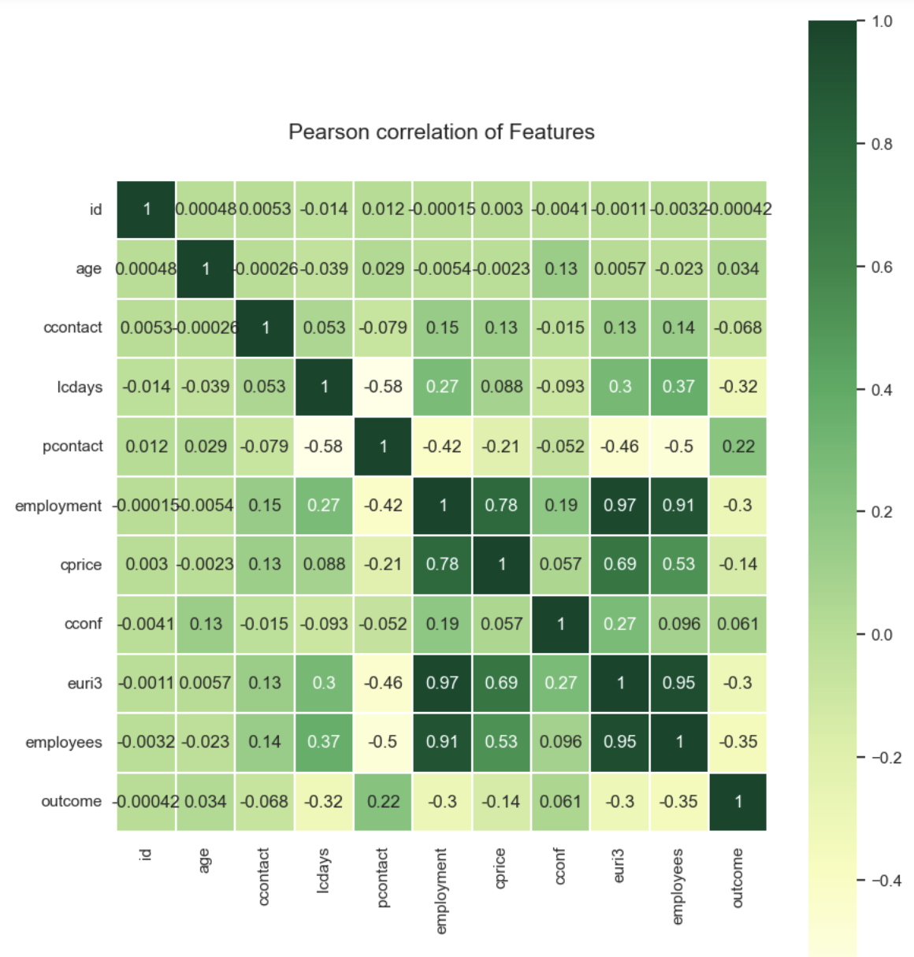
DATA UNDERSTANDING
54% of the customers who chose not to open a savings account were married.
82.5% of the clients lacked a personal loan, while 45.4% lacked a mortgage.
The majority of calls (78.6%) were placed between May and August, while the month of May saw the greatest proportion of callers who chose not to open a savings account.
Customers who opened or did not open a savings account are mostly between the ages of 38 and 40.
None of the clients have ever missed a payment on their credit. The remaining consumers' credit histories are unknown, and the majority of the customers do not have any credit defaults.
We can see from the heatmap that there are some numerical features that have a high correlation between them. For example, the correlation between employees and euri3 is 0.95, and the correlation between euri3 and employment is 0.97, which is very high when compared to the other features in the heatmap.

Slide 3
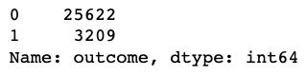
DATA PREPARATION
As our dataset has 10 categorical features we will need to encode these features into a numerical representation to apply the machine learning models.
In our dataset there are no missing values
Used PCA (Principal Component Analysis) to reduce the dimensionality of the data and transformed the data into a new space.
Since our dataset is imbalance we used SMOTE technique to oversample the minority class. It helped to balance imbalanced datasets and improve the performance of machine learning models.
Label Encoding is a popular encoding technique for handling categorical variables.
From the above distribution we can be sure that the data is imbalanced, as the number of "no"s are also 8 times the number of "yes"

Slide 4
Modelling
1
2
3
4
5
Artificial Neural Network (ANN)
Predictions on the test dataset
Model's Accuracy Score 0.8982
Applied Principal Component Analysis (PCA)
We utilized a Python script to develop an Artificial Neural Network (ANN) classifier that can train on a dataset and make predictions on a test dataset.
The model's accuracy score was computed to be 0.8982139760707474 on the test set.
Eliminates irrelevant columns and encodes categorical variables.
We partitioned the data into training and testing sets and applied Principal Component Analysis (PCA) to reduce it.
We utilized the model to make predictions on the test set and recorded the results in a CSV file.
The script reads in the training and test datasets, eliminates irrelevant columns, and encodes categorical variables

Slide 5
EVALUATION METHODOLOGY
The top 3 key features or attributes that helped in the prediction of the class variable were:
Euri3
Employment
Employee
Other than these 3 cprice and the categorical feature month and presult were also held a lot of importance in our case study
After doing univariate analysis of we figured that day does not help very much when it comes to predicting the target variable. But on the other hand, some numerical features tend to predict the target variable much better.
Model Selection
Train an ANN classifier
Used PCA
Model Evaluation
Split the data into train and test sets (80:20 split)
Train the ANN classifier on the train set
Predict the target variable on the test set
Evaluate the accuracy of the model

Slide 6
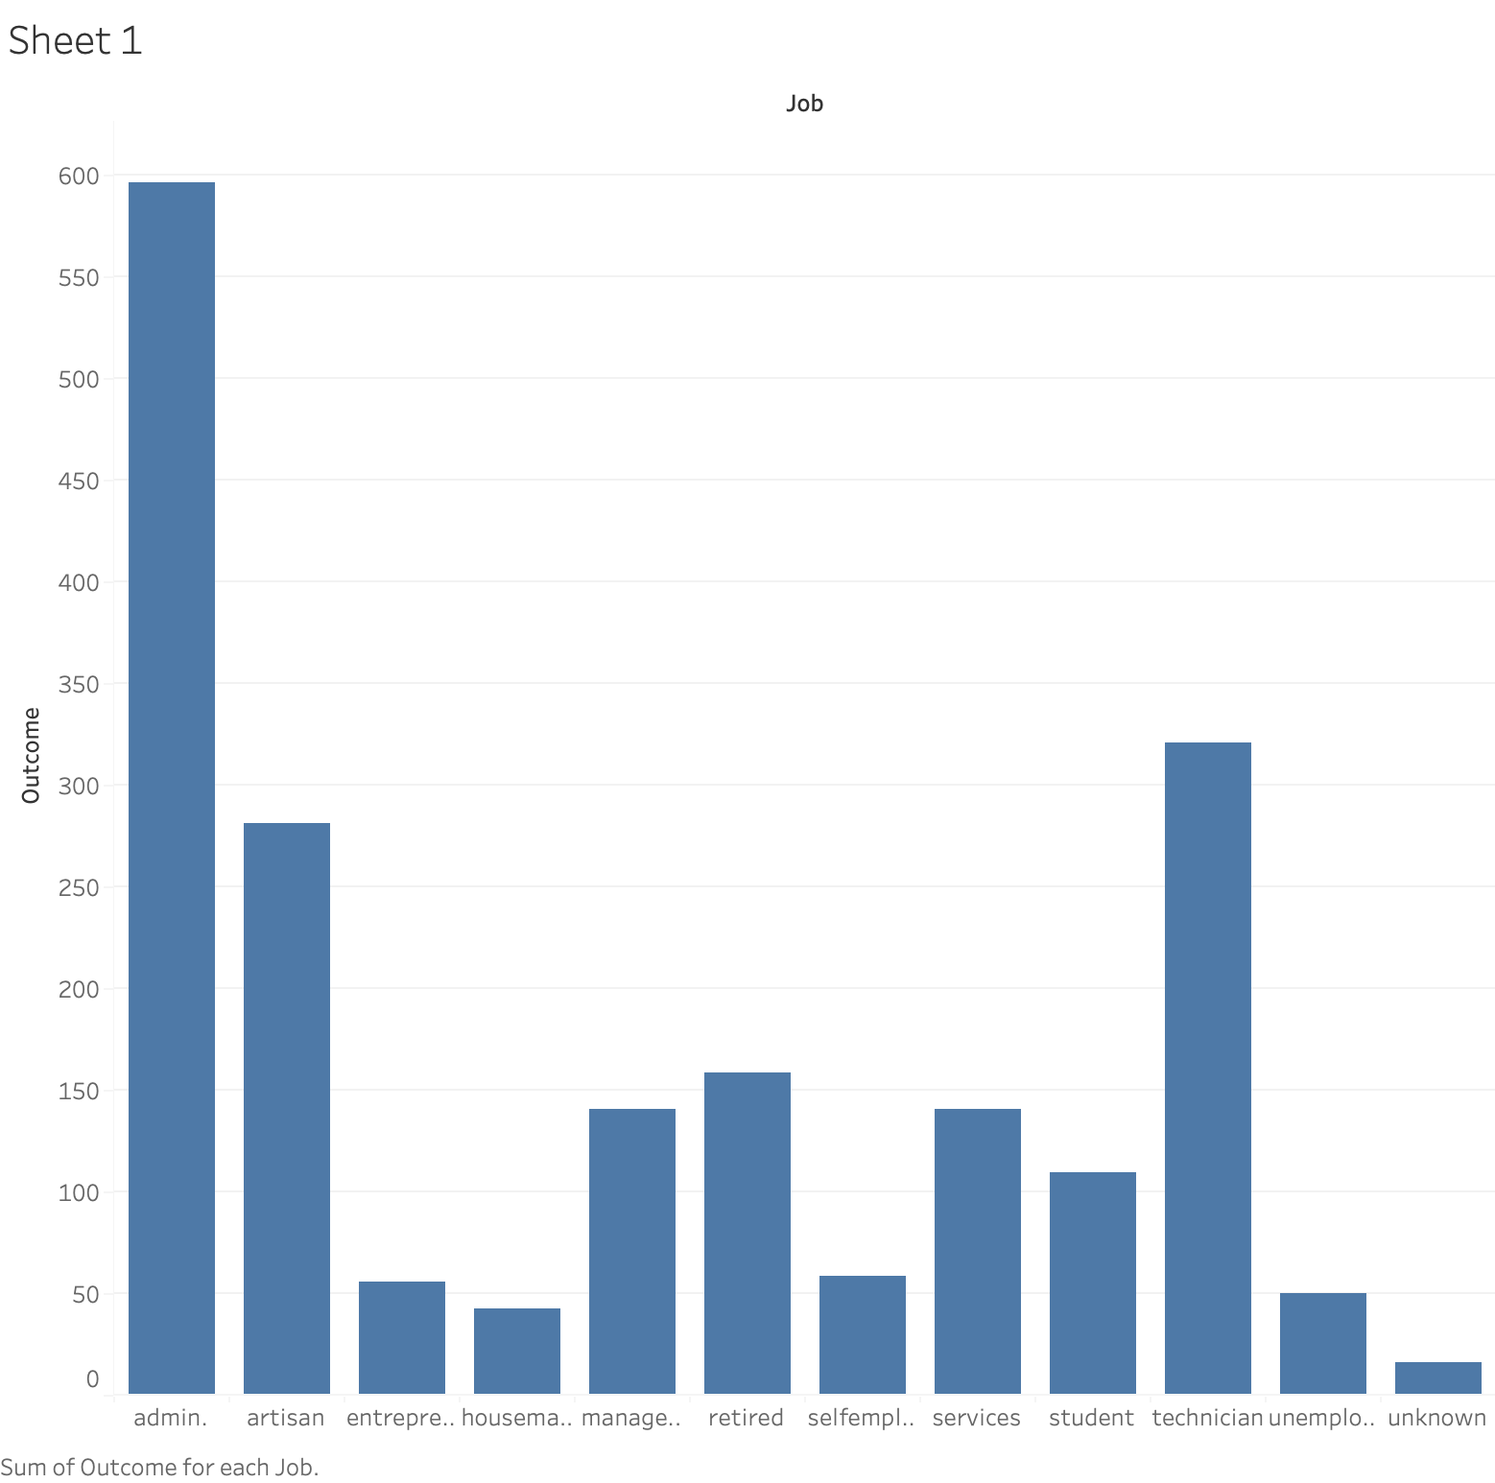
MANAGERIAL IMPLICATION
Identify Key Predictors: The most important predictors of whether someone will open a savings account are employment, euri3, and employee. The bank should focus on these customers in its marketing campaigns.
Improve Marketing Strategies: Direct mail and telemarketing are the most effective channels for reaching potential savings account customers. The bank should allocate more resources to these channels and tailor its messaging to maximize engagement and conversion rates.
Target Underserved Customer Segments: Retirees and students are underserved by the bank's current marketing efforts. The bank should develop targeted campaigns to reach these groups and adjust its messaging strategy to address their unique needs.
We have also included a graph that shows the predicted probabilities of opening a savings account based on the customer's job. This graph can help the bank understand which customer segments are most likely to convert and focus its marketing efforts accordingly.

Slide 7
THANK YOU

